Slide 1
Watercare Services Limited 2018/2019 Performance

Slide 3
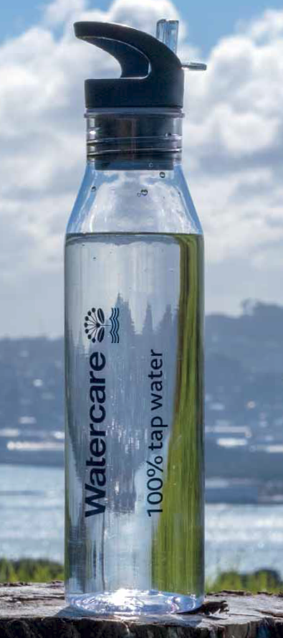
15 x SOI Measures achieved
Median response time for attendance to urgent call-outs
Median response time for resolution of urgent call-outs
Median response time for attendance to non-urgent call-outs
Median response time for resolution of non-urgent call-outs
Total number of complaints received by Watercare about any of the following: Drinking water clarity Drinking water taste Drinking water odour Drinking water pressure or flow Continuity of supply
Total number of complaints received by Watercare about any of the following: Sewage odour Sewerage system faults Sewerage system blockages
Attendance at sewage overflows resulting from blockages or other faults – median response time for attendance
Attendance at sewage overflows resulting from blockages or other faults – median response time for resolution
Number of dry-weather overflows from Watercare’s sewerage system, expressed per 1000 sewerage connections to that sewerage system
✓
✓
✓
✓
✓
✓
✓
✓
✓

Slide 4
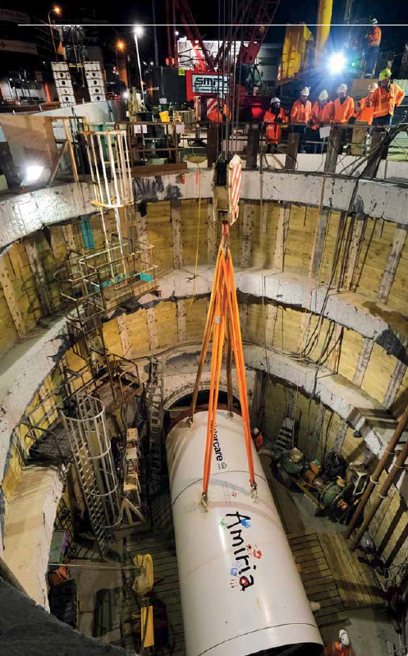
15 x SOI Measures achieved – continued...
Compliance with Watercare’s resource consents for discharge from its sewerage system measured by the number of: Abatement notices Infringement notices Enforcement orders Convictions Received by Watercare in relation to those consents
Average number of wet-weather overflows per discharge location
The average consumption of drinking water per day per resident (gross PCC) (12 month rolling average)
Net Promoter Score (NPS)
The extent to which Watercare’s drinking water supply complies with part 4 of the drinking water standards (Bacterial Compliance Criteria)
The extent to which Watercare’s drinking water supply complies with part 5 of the drinking water standards (Protozoal Compliance Criteria)
✓
✓
✓
✓
✓
✓
✓

Slide 5
1 x SOI measure not achieved
The percentage of real water loss from Watercare’s networked reticulation system (rolling 12 month average): Result: 13.1%. Target: ≤13.0%.
The water losses in this measure are calculated by deducting water sales volumes and unbilled water usage from the total volume of water produced.
These unbilled uses fall into three categories:
operational usage (pipeline flushing, fire-fighting, etc.)
meter under-recording; and
unauthorised usage (e.g. illegal use through hydrants, etc.)
Actions we are taking:
A taskforce is investigating unauthorised usage and is taking all necessary steps to address unauthorised use.
We are focusing on improving the accuracy of measuring total volume of water produced.
We are improving the accuracy of our Bulk Supply Points (BSP) to improve granularity of water supply data.

Slide 6
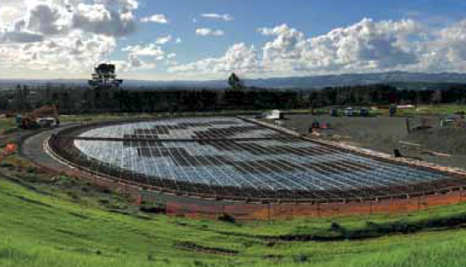
Highlights
We invested $447m in infrastructure.
In March 2019, we signed a construction contract with Ghella-Abergeldie Joint Venture for the delivery of the Central Interceptor. This $1.2 billion project promises to leave a legacy for wider Auckland, local communities and our industry.
All Central Interceptor procurement milestone dates have been met.
We commissioned a new water treatment plant for Warkworth, with water supplied from a secure underground aquifer, instead of the at-risk Mahurangi River. The new plant is a substantial investment and will double capacity and cater for growth in this fast-growing region.
We commissioned the first set of ‘containerised plants’ to service local communities in Warkworth, Owhanake and Clarks Beach while the existing facilities are going through significant upgrades. These plants use the sustainable membrane bioreactors (MBR) to treat wastewater.
We won a number of engineering and project management awards over the year. In particular, our Biological Nutrient Removal (BNR) facility at Māngere was recognised multiple times both in NZ and internationally.

Slide 7
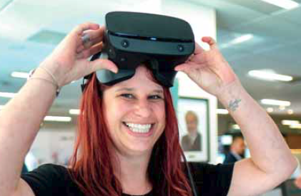
Highlights
We announced our ambitious 40:20:20 vision. This challenges our business to:
reduce carbon in construction by 40% by 2024;
reduce the cost to deliver our infrastructure programme by 20% by 2024; and
improve health, safety and wellness by 20% year on year.
We increased digital interactions by 19% with customers.
We introduced new and improved digital systems for procurement, finance and project management.
In August 2018, we released a digital tool that allows us to easily see our high-priority water and wastewater incidents in real-time. This allows us to identify where an incident is, what caused it, whether or not it has happened before, as well as an update on whether our crews have arrived on site and are remedying the situation.
Our new mobile-friendly website went live.
We opened our maintenance training facility at Māngere. The training centre was recognised for its originality at the Water NZ 2018 conference with an award for innovation in safety.
We sustained a cyber-attack. However, our incident management allowed us to respond quickly and thwart the attack – keeping company, customer and staff information safe.

Slide 8
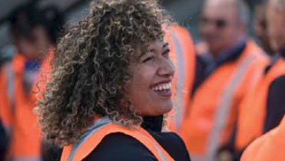
Highlights
We now have two online systems – IMMERSE for staff learning and SURF for career development.
We established a Diversity and Inclusion Committee.
The Health, Safety and Wellness team now has a dedicated wellness lead and programme to support our people with workshops, early intervention, recovery and resilience building.
Our people are increasing their understanding of tikanga Māori as well as their ability to speak te reo. We run an intensive ‘Te Kunenga o te Ao Tikanga’ course offered by Te Wānanga o Aotearoa.
Our staff survey delivered pleasing results – the overall engagement score remained stable at 67, with the results suggesting that staff are confident in Watercare’s leadership and believe our company cares about the environment. Many staff reported greater collaboration and team work this year and 76% said they enjoy working for Watercare.
We are joining Fulton Hogan and GHD for Project New Grad; a three year graduate development programme.
We are partnering with the University of Auckland to build a work-ready pool of graduates.

Slide 9
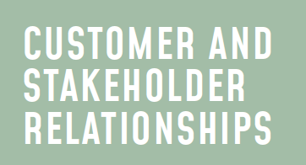
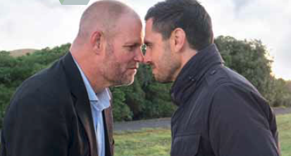
Highlights
We supplied safe and reliable ‘Aa’ graded water, at all times, exceeding the required Drinking Water Standards for New Zealand’s criteria for water quality and supply infrastructure.
We met all SOI targets relating to attendance and resolution of water and wastewater issues such as outages, blockages and other faults.
We actively collaborate with all members of the Council whānau, iwi leaders, central government and other interest groups to ensure we deliver great collective outcomes for Aucklanders.
Our Net Promoter Score (NPS) rose to 43. This means significantly more customers talk positively about us than the number who do not (other utilities can score negatively).
In October 2018, we launched our new-look Facebook page and also have a social media profile on LinkedIn.
In January 2019, we signed a partnership agreement with Plunket to educate families about what they can and cannot flush down the toilet.
We work with the Water Utilities Consumer Assistance Trust to assist customers having difficulty paying their water bills. In 2018/2019, Watercare forgave $120,000 of debt.
Our education coordinator visited 31 schools around Auckland and delivered 290 lessons on water and the environment.

Slide 10
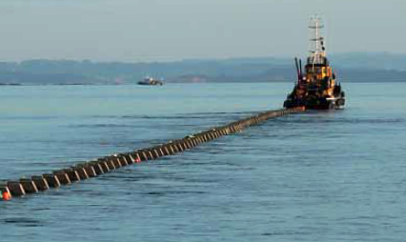
Highlights
Revenue was $715m, exceeding our target of $651m due to higher levels of demand from customers and increased residential development across the region.
Our operating surplus was $176.4m, which was up 45% from 2017/2018.
We achieved $25.3m of savings on capital expenditure and operating expenditure.
Our debt rose by only $84m (to $1.7b) despite capital expenditure being at an all-time high ($447m in 2019).
We continued to proactively explore opportunities for efficiencies across the business and achieved just under $7.7m in efficiency gains. Efficiency for us means delivering best value for money and doing more with less.
In July 2018, we dis-established our treasury function and began utilising Auckland Council’s centralised treasury team. This enabled us to borrow at a lower cost of funds and saved us $7.4m in interest costs during the 2019 financial year.
We worked with the Value for Money team at Auckland Council with the s17A reviews into Three Waters, Communications & Engagement, Procurement, Customer Services and ICT.

Slide 11
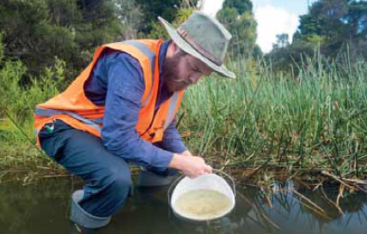
Highlights
We achieved the targets we set for Phase 1 of our energy efficiency and neutrality programme – saving 8GWh of energy through various process improvements across our treatment processes.
We planted 86,500 native trees in the Hūnua Ranges to improve slope stability and water quality.
In July 2018, Watercare was one of around 60 companies that launched the Climate Change Coalition which aims to promote business leadership and collective action on the issue of climate change.
We launched our Climate Change Strategy. This provides a road-map for Watercare to achieve Net Zero Carbon by 2050 (mitigation) and reduce greenhouse gas emissions by 45% by 2030. It will also assess the actions we need to take in relation to our physical assets, to ensure these remain fit for purpose in a changing climate over the next decades (adaptation).
In May 2019, we opened our first solar array at our Pukekohe Wastewater Treatment Plant. The 400 solar panels can generate about 170 megawatt hours of energy per year and save us $20,000/year. A further three solar array installations will be commissioned over the next financial year.
At our Rosedale Wastewater Treatment Plant we are building a thermal hydrolysis facility that will be completed in 2022. This will allow us to sterilise the biosolids from the treatment process and create fertiliser that can be used for beneficial purposes.

